Slide 1


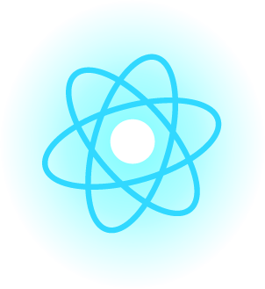
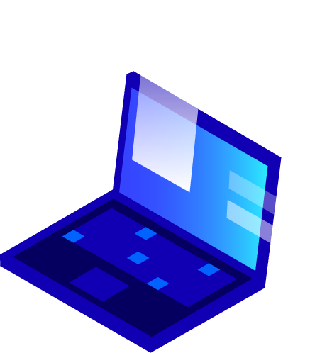



FLUTTER WORKSHOP

Slide 2





Installation and set-up
What is Flutter?
Agenda
Why Flutter?
Overview of Flutter architecture
Quick review of Functions, Classes, and Objects - Demo

Slide 3
What is Flutter?
Mobile UI for creating apps for both iOS and Android systems
One code-base for both operating systems
One code-base for both operating systems
One code-base for both operating systems
Uses Dart as a programming language
Uses Dart as a programming language
Uses Dart as a programming language

Slide 4
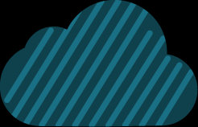
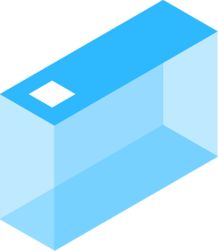

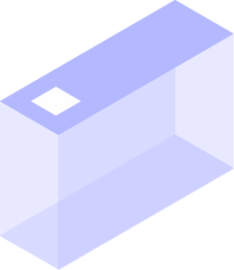
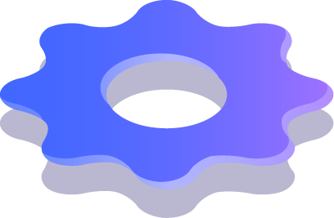
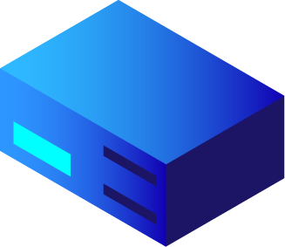

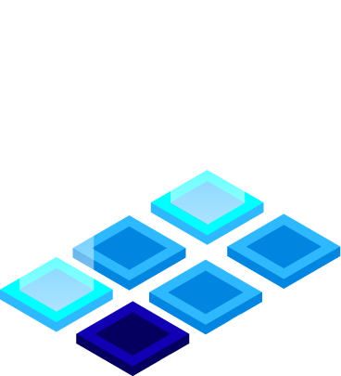

Why use Flutter?
Easy-to-use with only 1 code base
Has great documentation and guides
Integrates with Firebase (Online Database often used as a backend service)
It is an open-source framework
Flexible to allow user to customize design

Slide 5
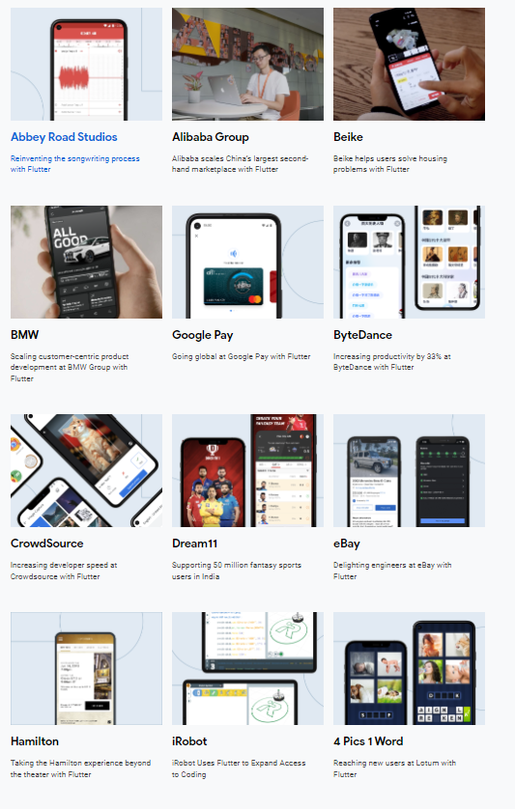
Apps currently made with Flutter
JD Finance
Pairing
Meeve
n8
Music Tutor
Topline
Google Ads
SG Bus tracker

Slide 6
How does Flutter operate?
A combination of widgets
Common widgets that are used include:
Text widget
Button widget
Row widget
Column widget
Image widget

Slide 7
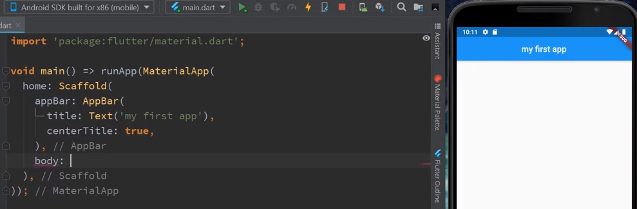
Scaffold Widget
A Scaffold Widget is basically a wrapper to a few different layout widgets.
For example, the app bar, the body, and a floating action button.
Provides a framework which implements the basic material

Slide 8
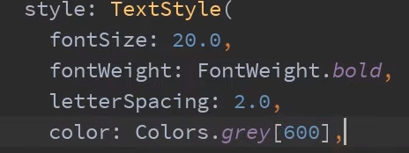
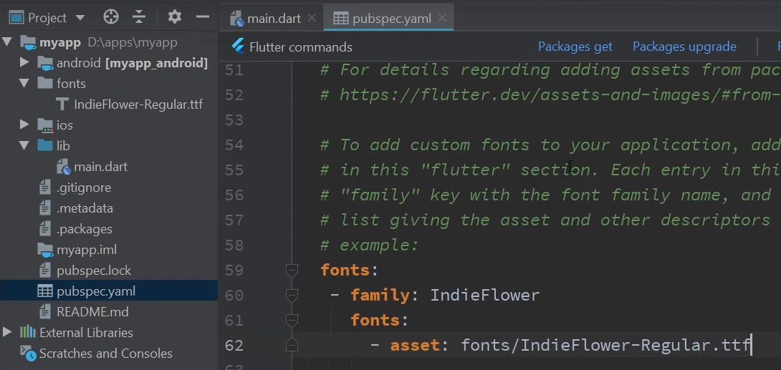
Text Style Widget
Allows you to customize text
Allows you to change text:
- Font size
- Ability to bold text
- Letter spacing
- Color
- Font

Slide 9
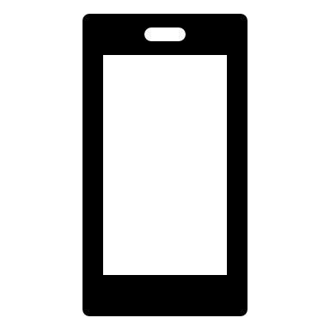
How does Flutter operate?
Parent Widget. Example: Scaffold()
App title
Information about your app
Container Widget
App Bar Widget
Text Widget
Text Widget

Slide 10
Hot Reload & Hot Restart
Hot Reload
- Reloads that app but saves the environment variables.
Hot Reload feature helps you quickly
- Easily experiment
- Build User Interfaces’
- Add features
- Fix bugs
Hot Restart
- Reloads the entire app

Slide 11
Scaffolding and AppBar Demo

Slide 12
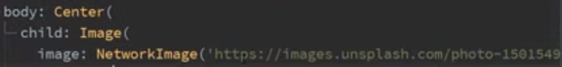
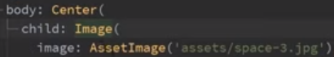
Image widget
Images can be added via online links or files from your desktop.
NetworkImage()
displays images from the internet
You can copy a url by right clicking an image online and clicking “copy image url”
Assetimage()
Inputs local image on your personal computer.

Slide 13
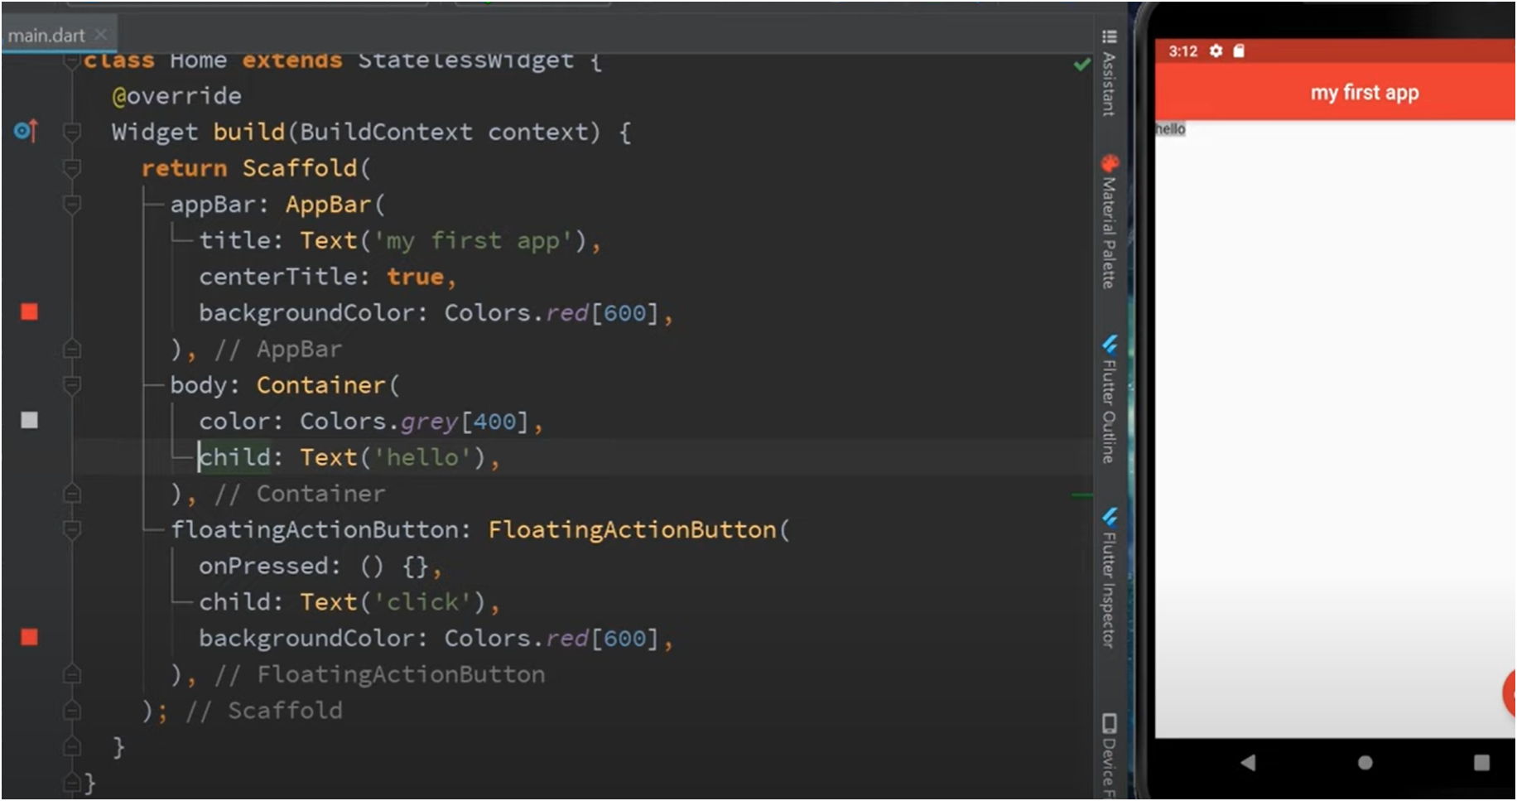
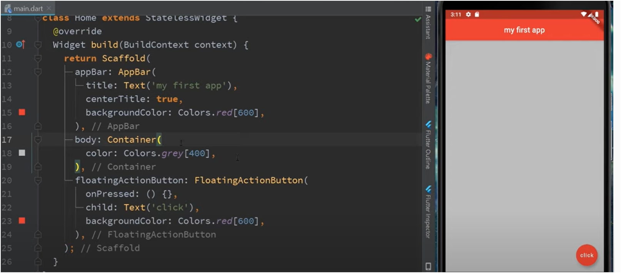
Container
Container widget: it helps contains all of the widgets and it comes with properties like padding, margin and color
Body: Container (container for the widgets
Color: Color. grey[400] (this is the color of the container)
The container is only confined to the child widget text “hello”
This makes the container grey , which is represented by the whole rectangle
Notes:
Bottom picture:
Child: Text ('hello'), container the text will appear as hello, but notice now that the grey only surrounds the widget inside and everything else is white. This is because it only covers the container. The container restricts itself to that child widget

Slide 14
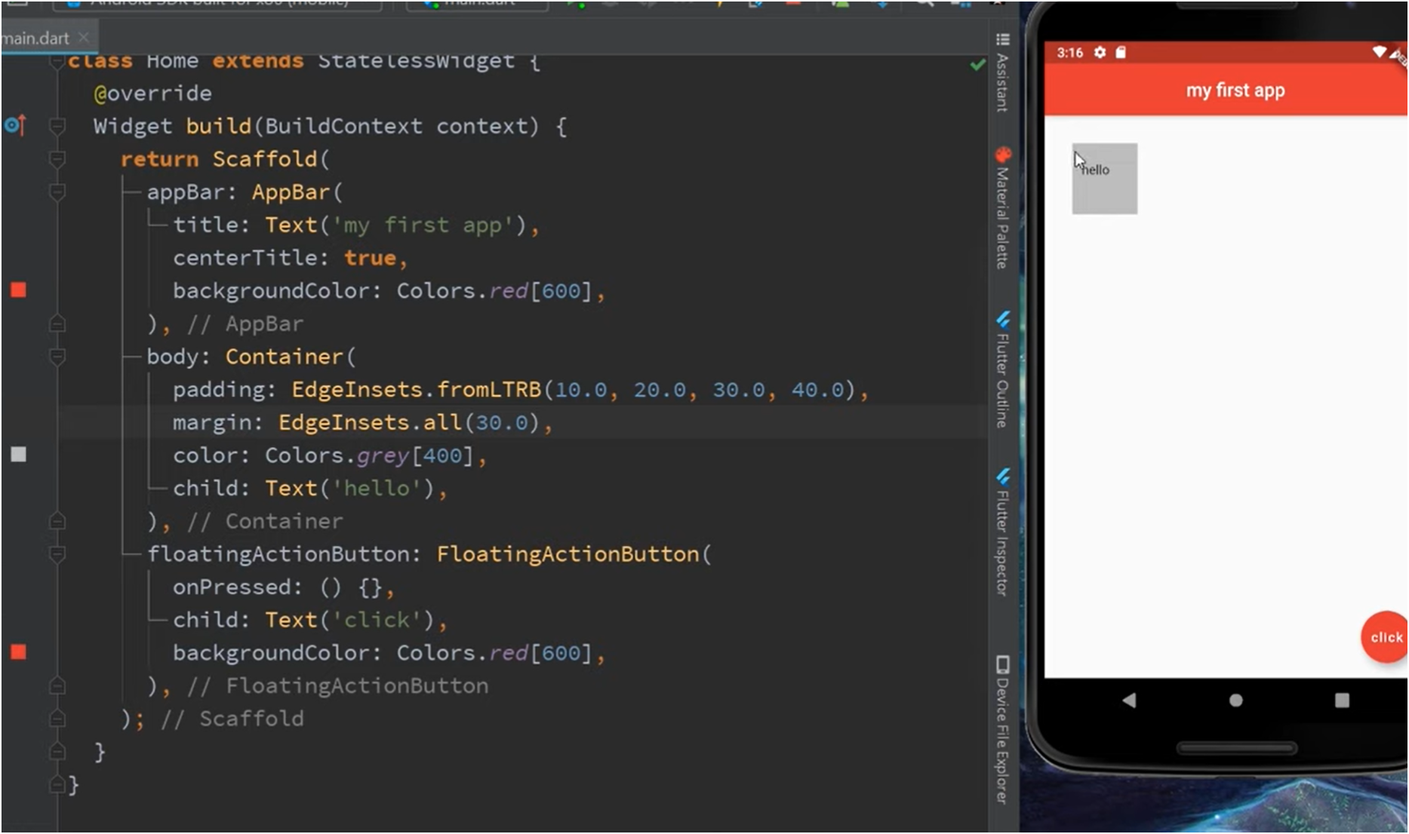
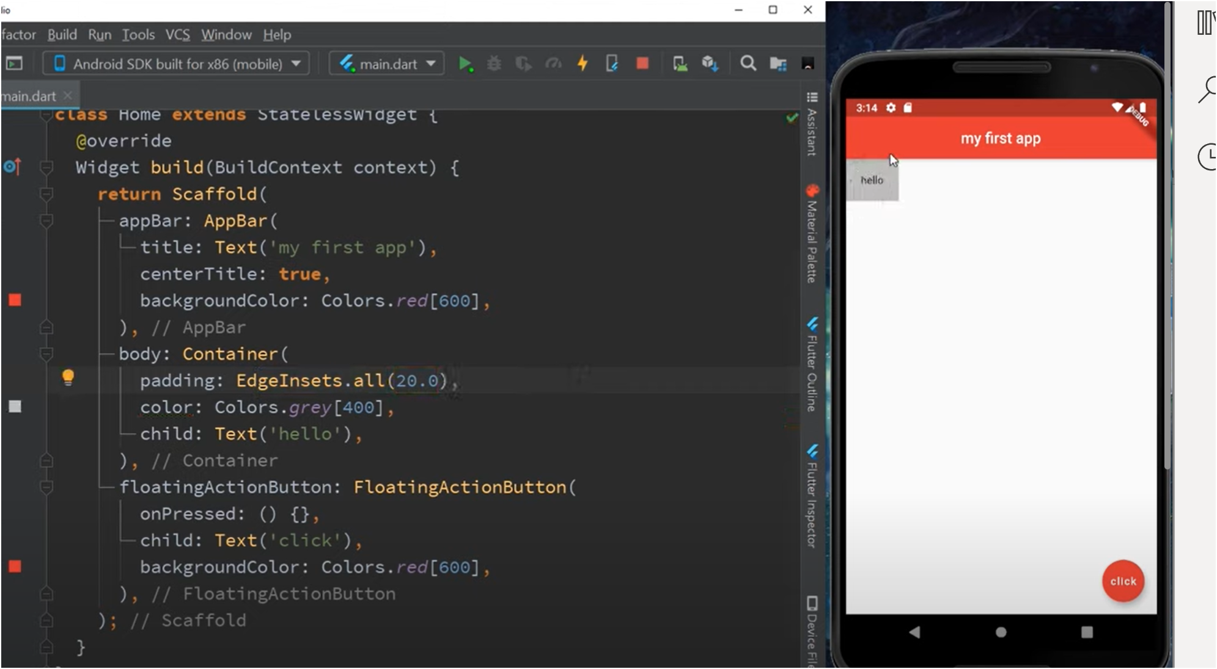
Padding & Margin
Can be used to change the container to whatever shape and size
Function: Edgeinsets()
- this is how you control padding and margin inside flutter
Padding : EdgeInset.all(20) will add 20 pixels of padding around all edges
Margin: is around the container

Slide 15

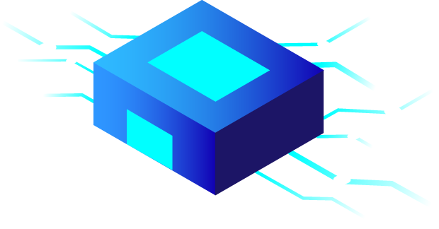
Containers Demo

Slide 16
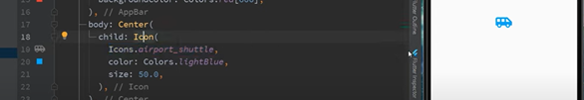
Icons
Icon is a widget that can be added to the app to show symbols. To do this set Icon as a child class
Within the child class of icon, you can specify which icon you want, the color, size etc.

Slide 17
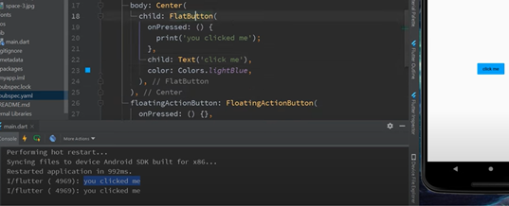
Button
Create a child class and specify what type of button you want. It can be a flat button or a raised button
onPressed : When the button is pressed a functions will be executed. This case it will state you clicked me
Child: text (will appear in the button)
Color: can use any color you want
If you press Control +Q it will list all the other attributes that can be apart of the button class

Slide 18
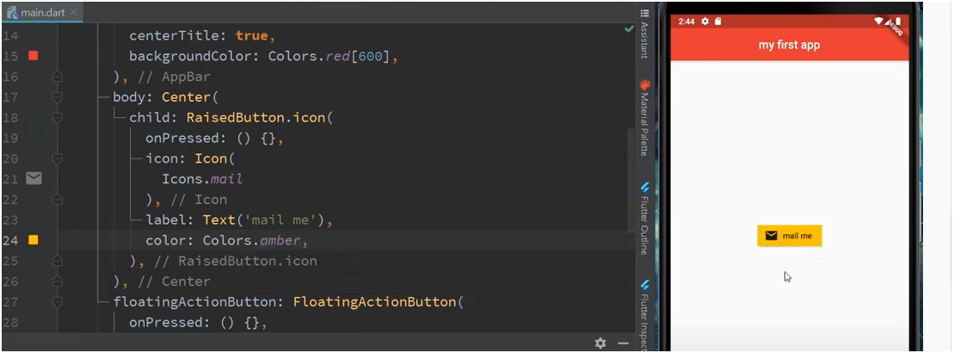
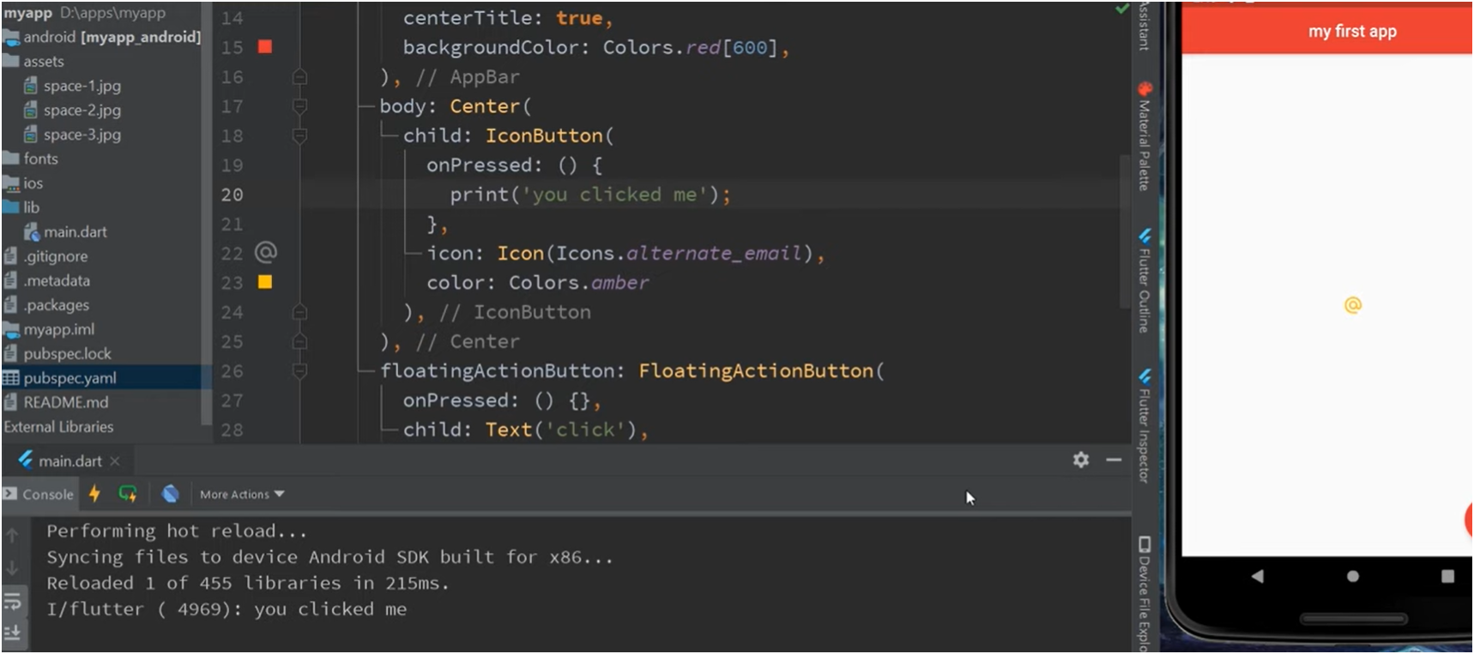
Adding an Icon to the Button
Child: Raisedbutton.icon (this means want an icon inside the button)
Same rules apply as earlier shown earlier
Or you can make the icon as a button shown in the bottom figure
Making the icon appear in the button
You can have an Icon Button

Slide 19
Icons and Buttons Demo

Slide 20
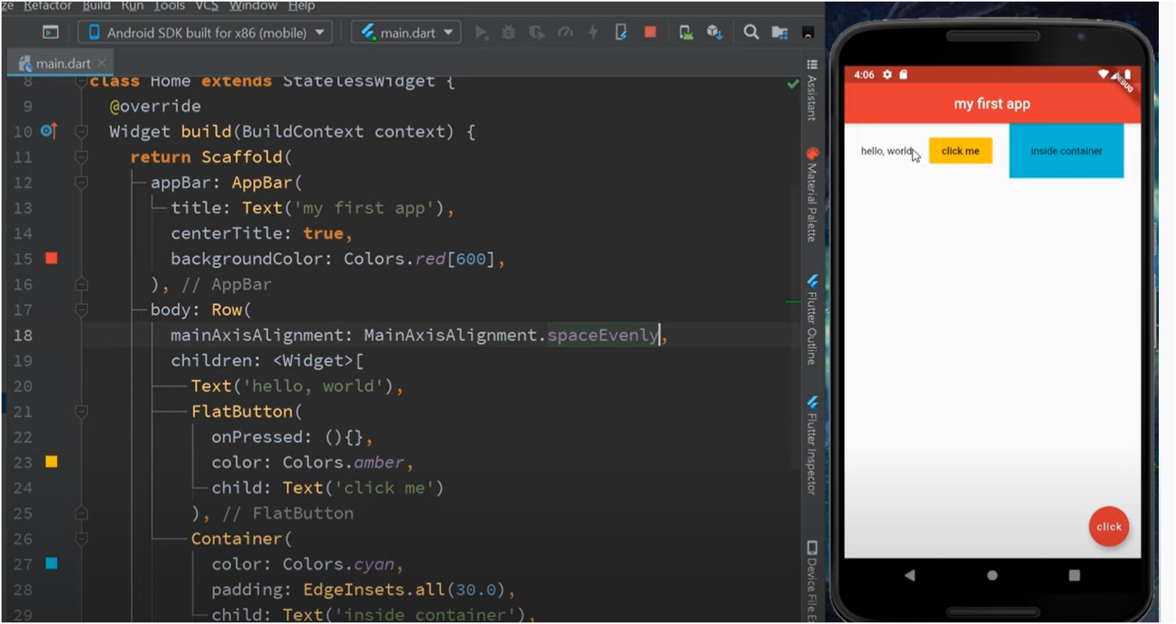
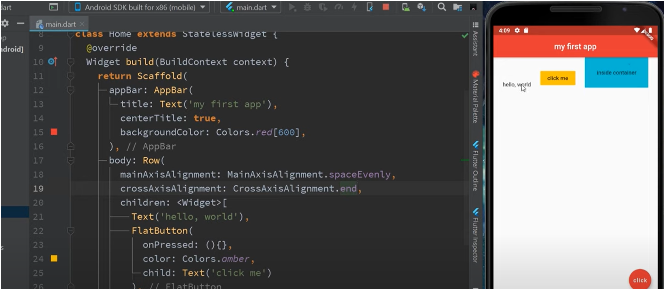
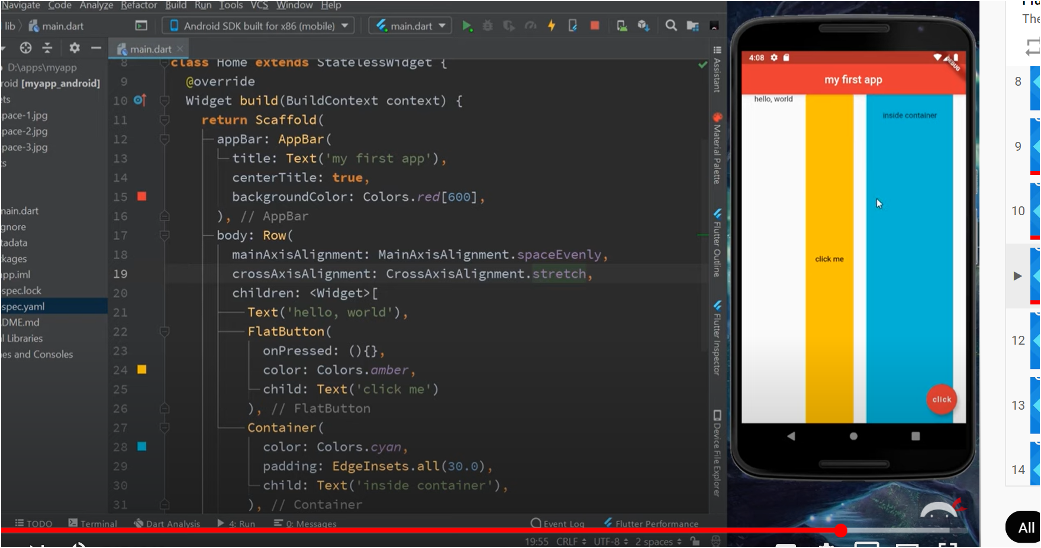
Rows
Figure: MainAxisAlignment.spaceEvenly places the widgets evenly along the horizontal axis
Figure: CrossAxisAlignment.end allows the smallest widget to be at the bottom of the highest widget along the vertical axis
Figure: CrossAxisAlignment.stretch stretches the widget across the vertical axis

Slide 21
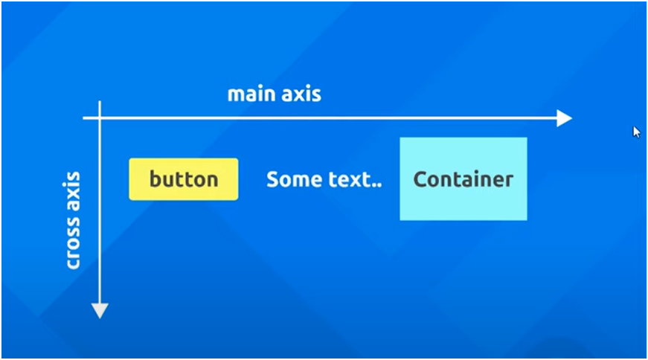
Rows
Row is a widget itself
- Therefore you can stack multiple widgets within a row
- You call upon the children[] property which puts all the widgets in a list
Main axis
- Allows for a horizontal shift
- Function : MainAxisAlignement.()
Cross Axis
- Allows for a vertical shift
- Function: CrossAxisAlignment.()

Slide 22
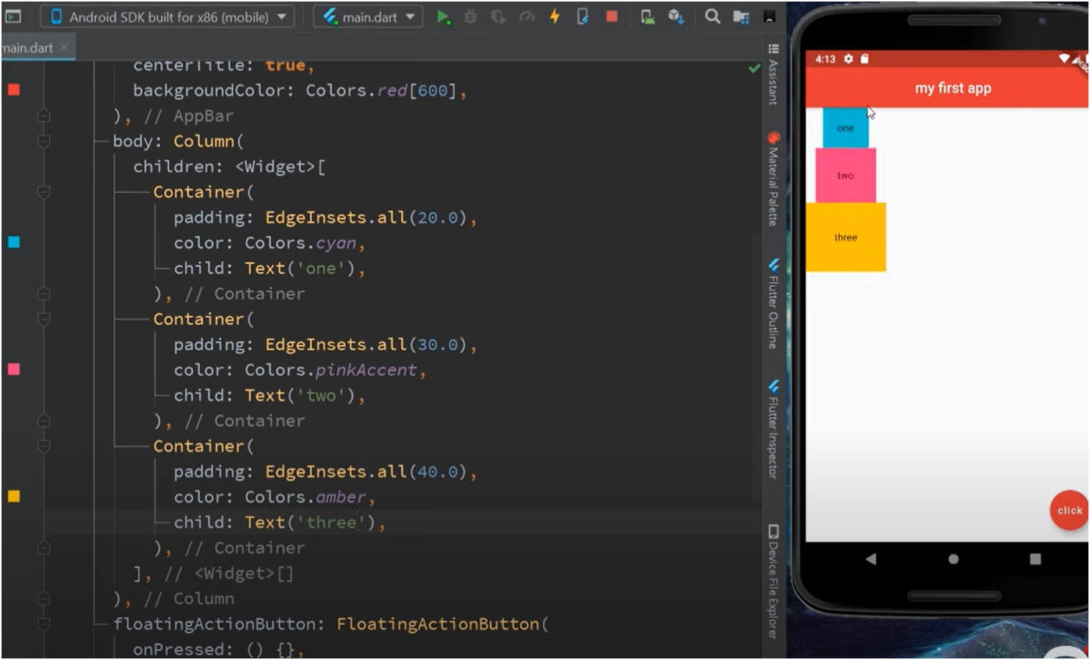
Columns
Elements stacking on top of the other
Main axis
Allows for a vertical shift
Function: CrossAxisAlignment.()
Cross Axis
Allows for a horizontal shift
Function : MainAxisAlignement.()

Slide 23
Rows & Columns Demo

Slide 24
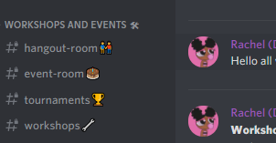
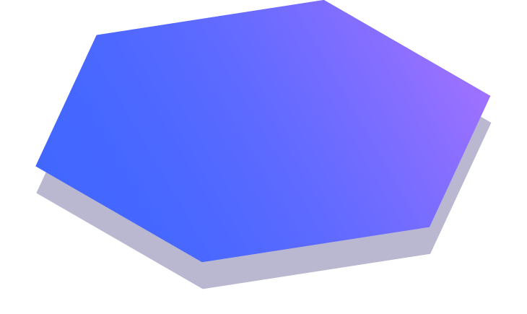
Questions ?
Exit Survey Password:
FLUTTER
You can contact us on Discord and ask questions in the #workshops channel:
@Sarah (DeltaHacks)
@Ayman (DeltaHacks)

